Slide 1
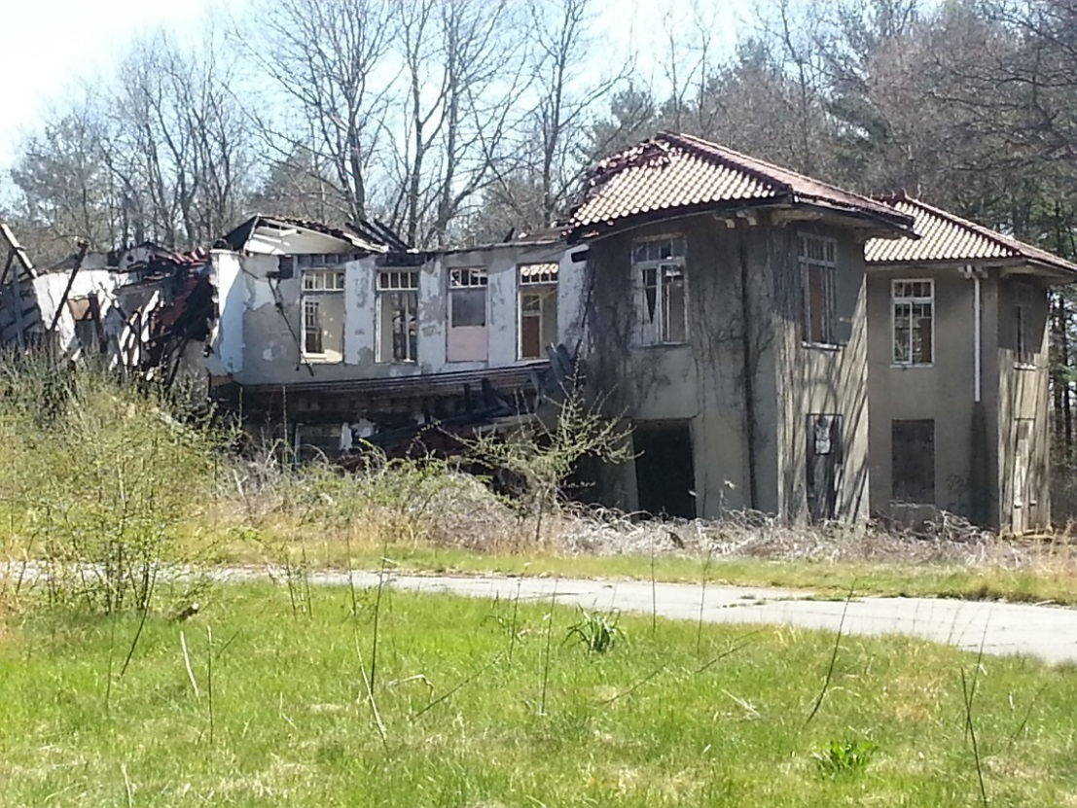
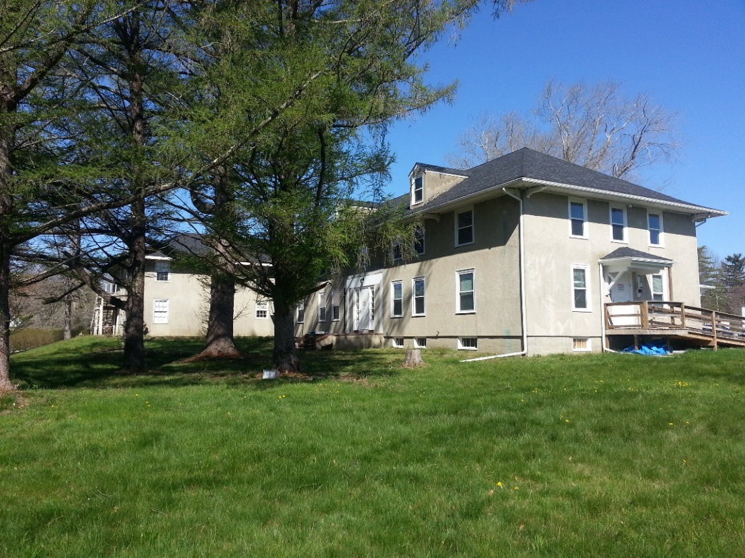
2nd Progress Report from the Plymouth County Hospital (PCH) Reuse Committee
September 28, 2016

Slide 2
General info about PCH Grounds
55 acres total
Frontage on High Street and Pierce Avenue
Hanson obtained the land in 1999
5-6 studies of property over a 16-year period. Results combined in Old Colony Planning Council feasibility report.
Includes 2015 community survey
Several town committees have grappled with what to do with this property.

Slide 3
Map of PCH site
Meadow
Parcel 3 – trails and meadows
Parcel 2 existing buildings and land (plus u-shape around parcel 1)
Parcel 1 – old hospital building
High Street

Slide 4
Three Parcels
PARCEL 1: Old hospital building plus land (8 acres)
building is beyond repair and needs to be demolished
PARCEL 2: U-shaped land surrounding the hospital plus additional buildings and land (24 acres)
Building with Hanson Food Pantry and Beekeeper’s Association
Hanson Community Garden
Water tower and smaller buildings
A variety of community-oriented uses suggested
PARCEL 3: Thin strip of land leading to large meadows (22 acres)
In back of property heading north toward Wampatuck Pond and Town Hall
Most studies recommend this land for open space or conservation

Slide 5
Parcel 1 – Old hospital building (8 acres)

Slide 6
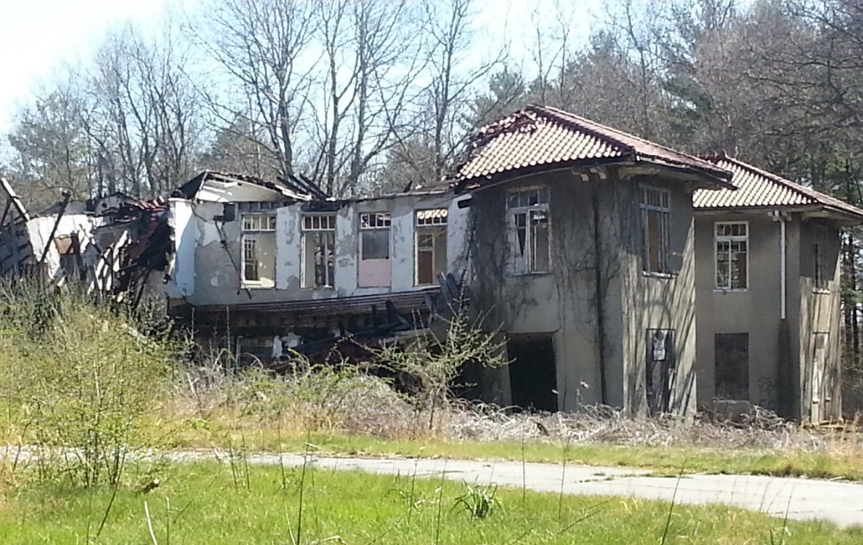
Parcel 1 – Old hospital building (8 acres) (picture take before it further collapsed last week)

Slide 7
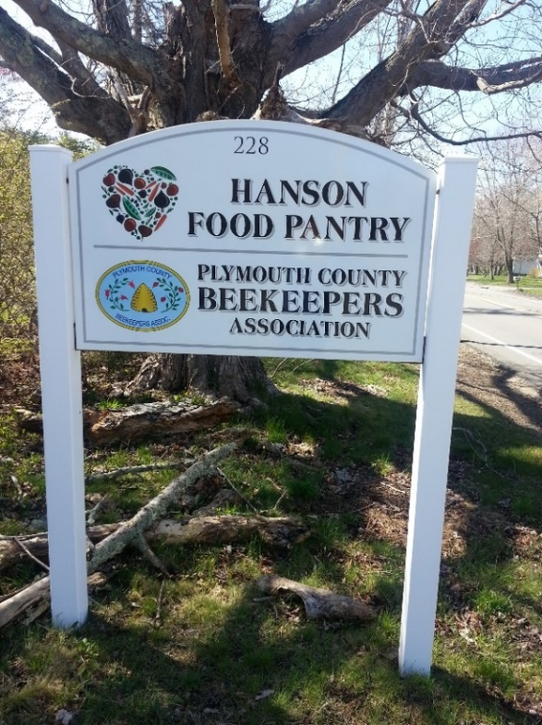
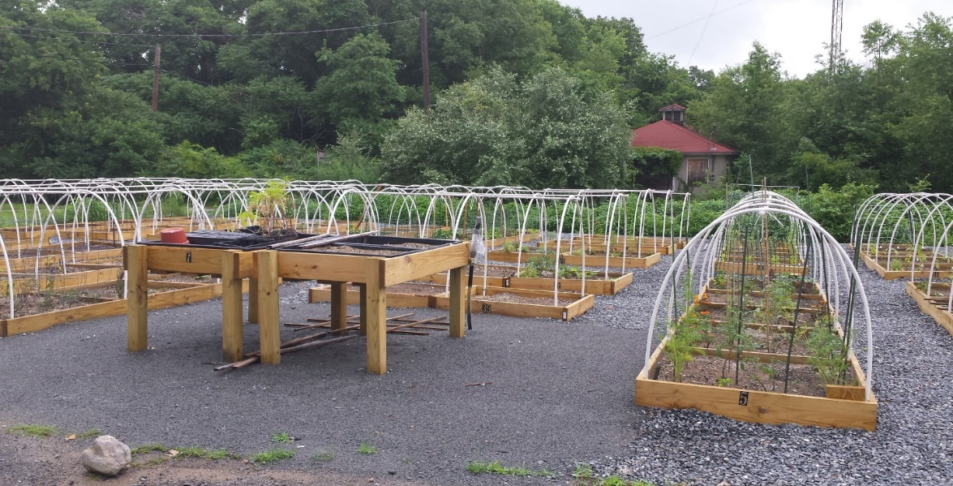
Parcel 2 – Food pantry, community garden, water tower, other buildings (24 acres)

Slide 8
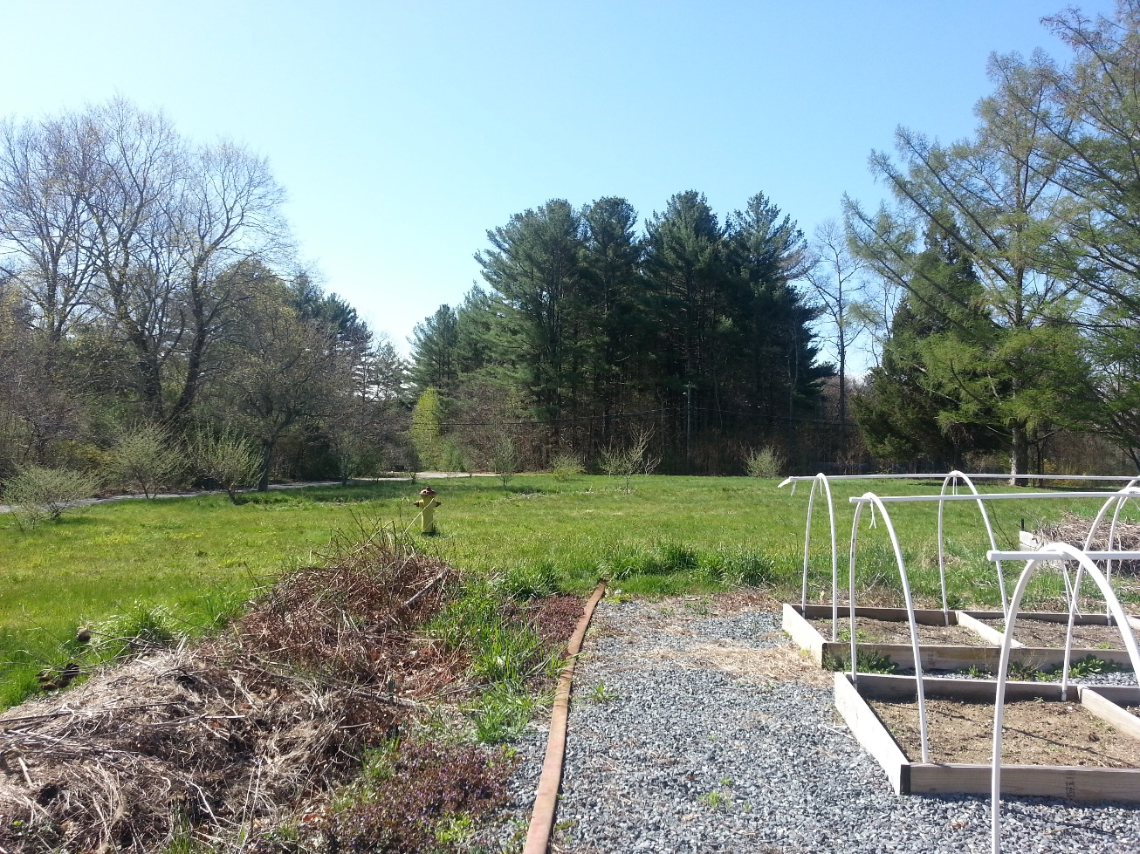
Parcel 2 (con’t)

Slide 9
Superintendent’s House – on High Street

Slide 10
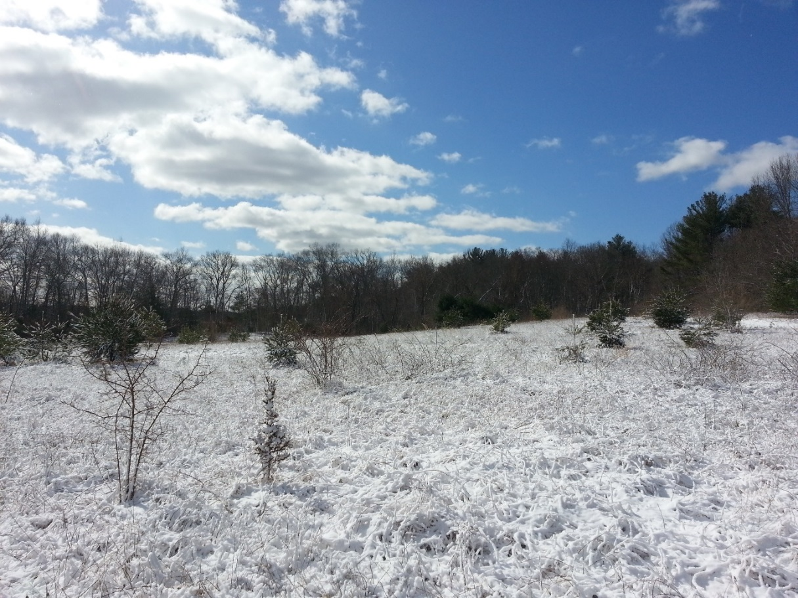
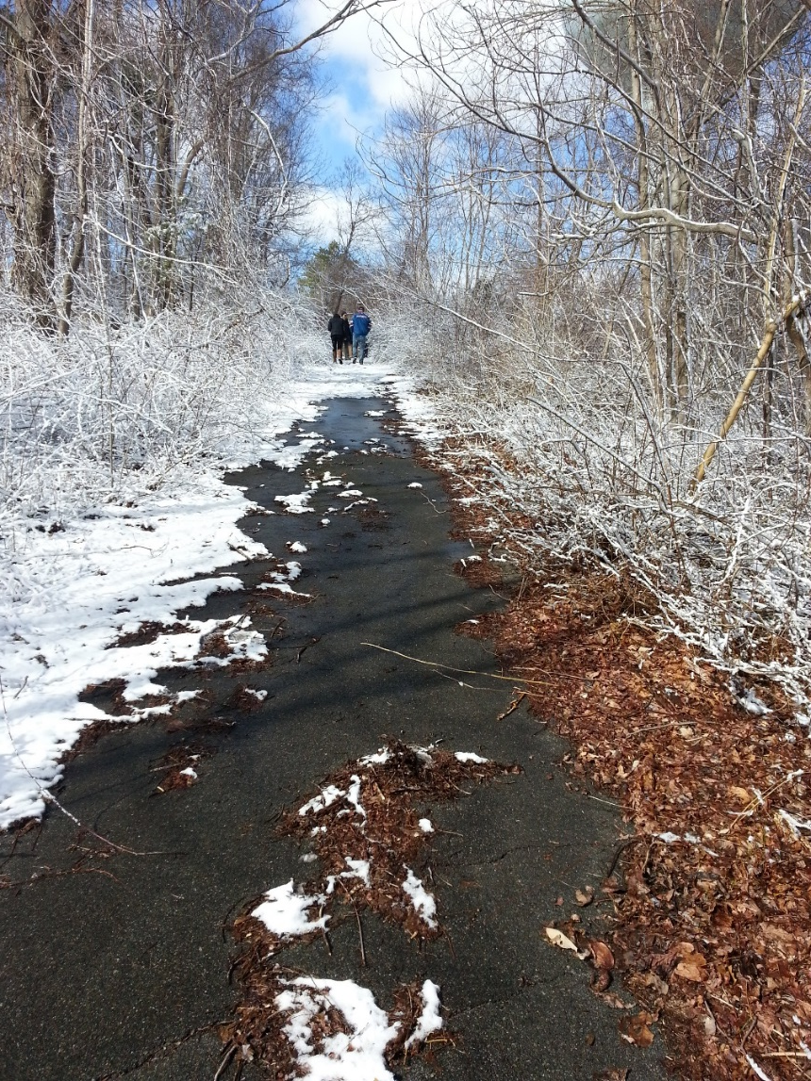
Parcel 3 – trails and meadows (22 acres)

Slide 11
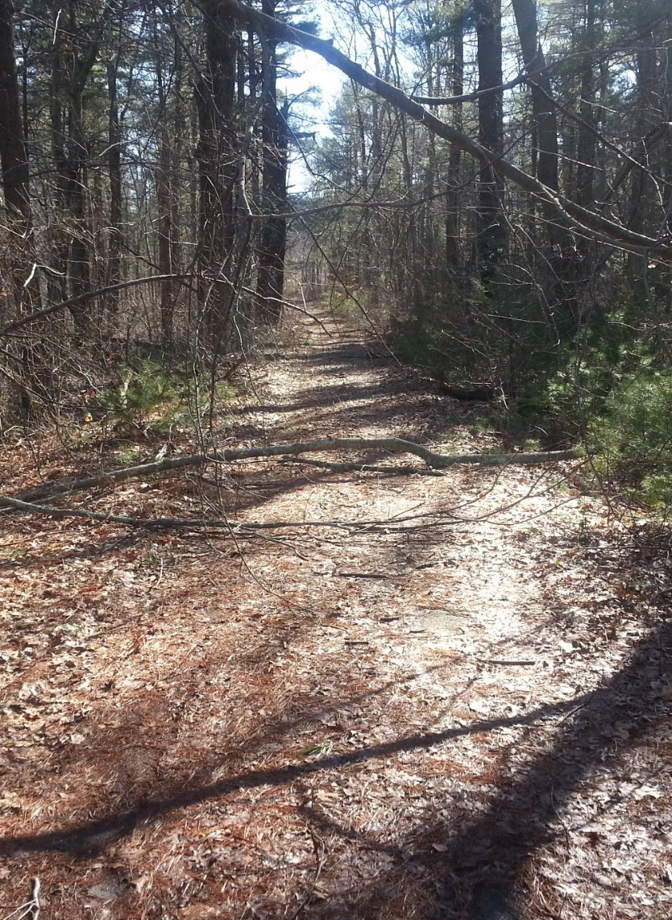
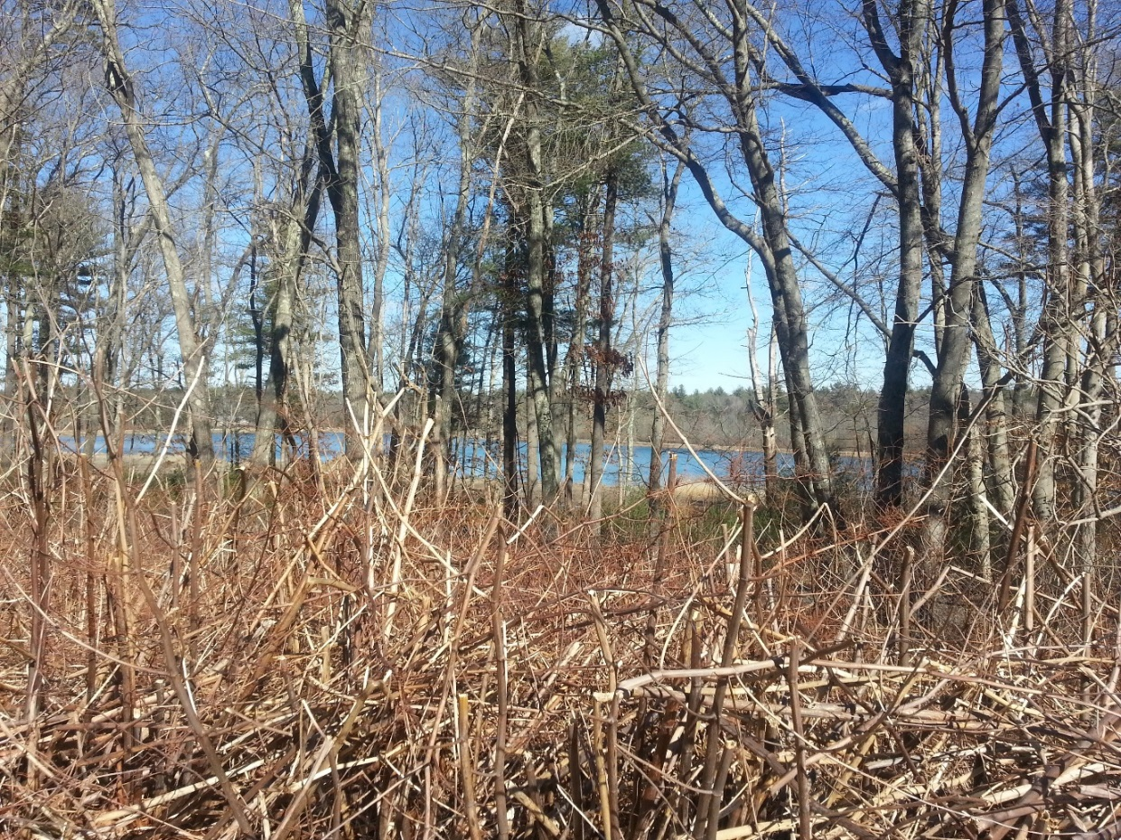
Parcel 3 -trail and meadows (con’t)

Slide 12
Committee focused on hospital parcel first
Prior studies indicate building needs to be demolished; condition has worsened
One section (annex) caved in last week; emergency demolition taking place this week
Some hazardous materials
Demolition is expensive
Explored options to benefit town of Hanson and limit taxpayer cost

Slide 13
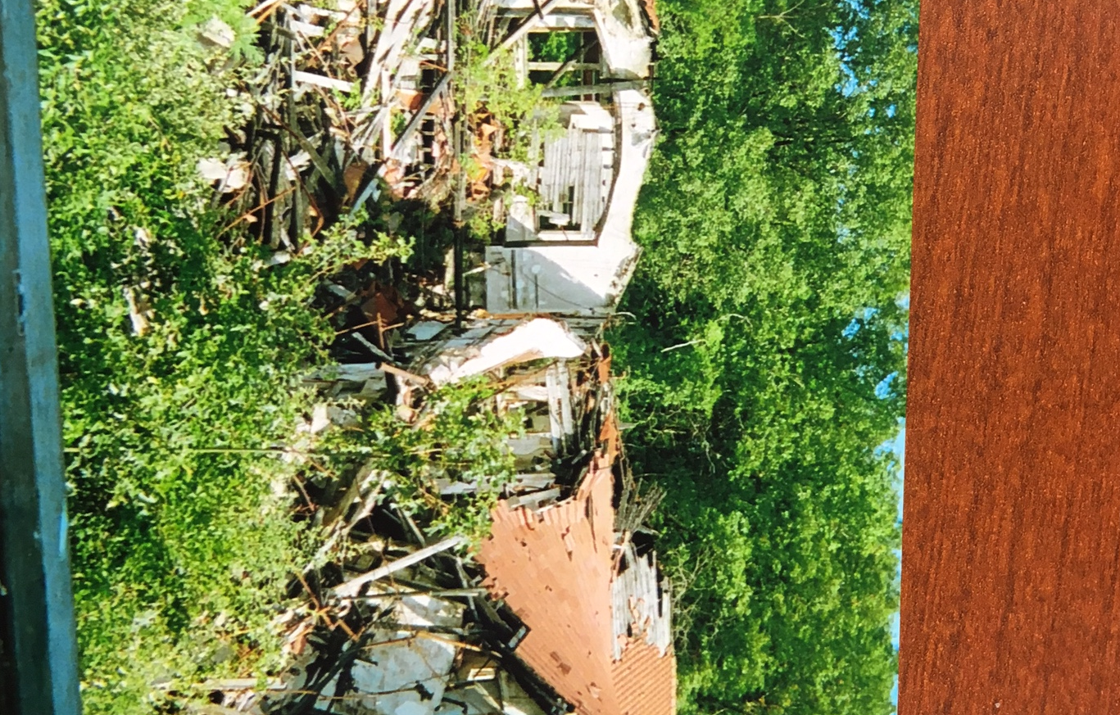
Picture taken before it further collapsed last week

Slide 14
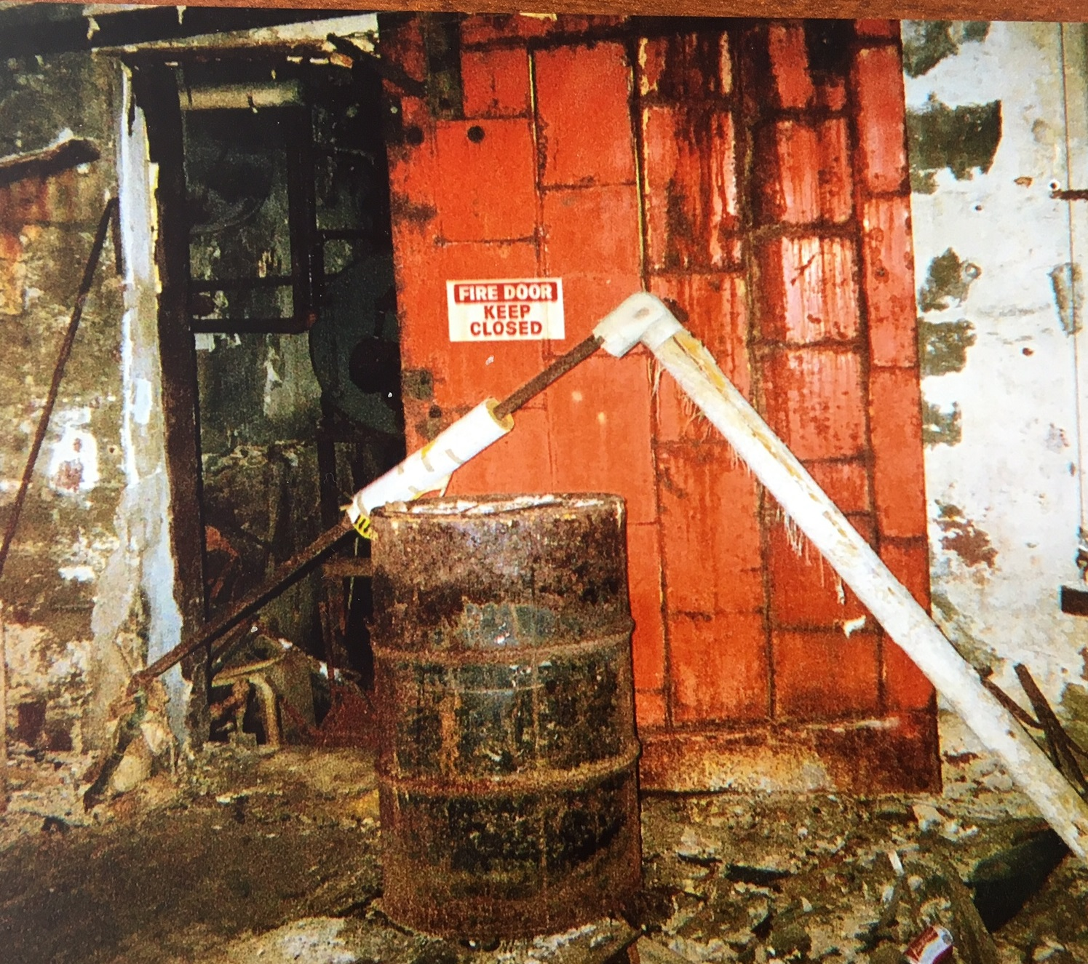

Slide 15
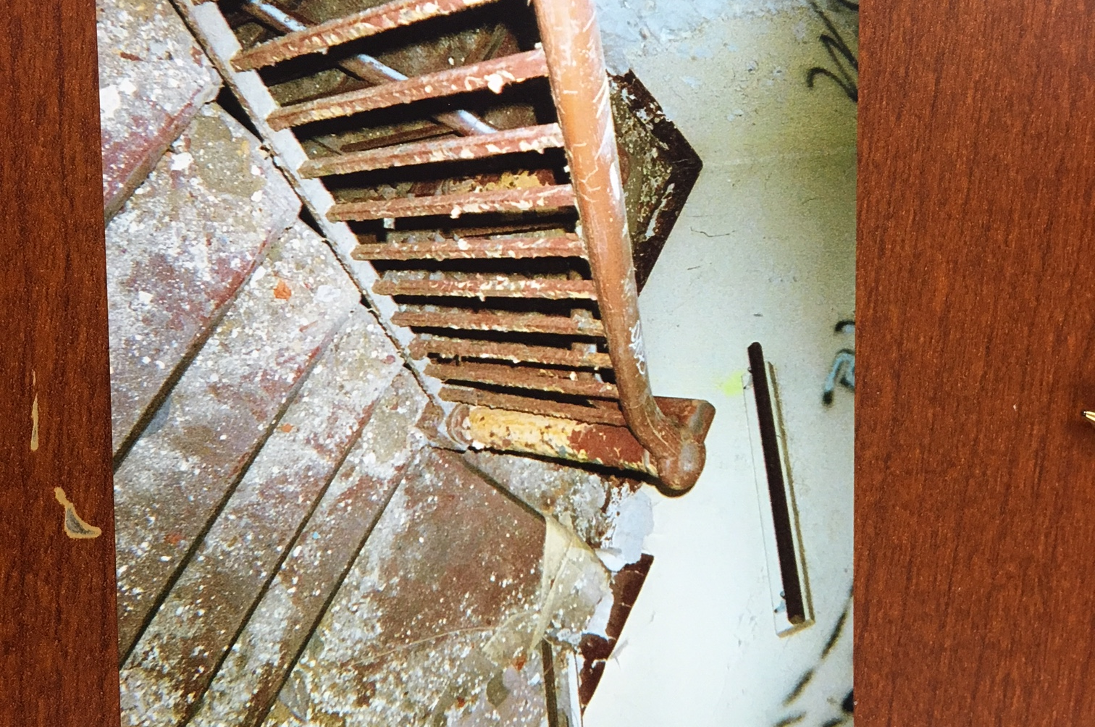

Slide 16
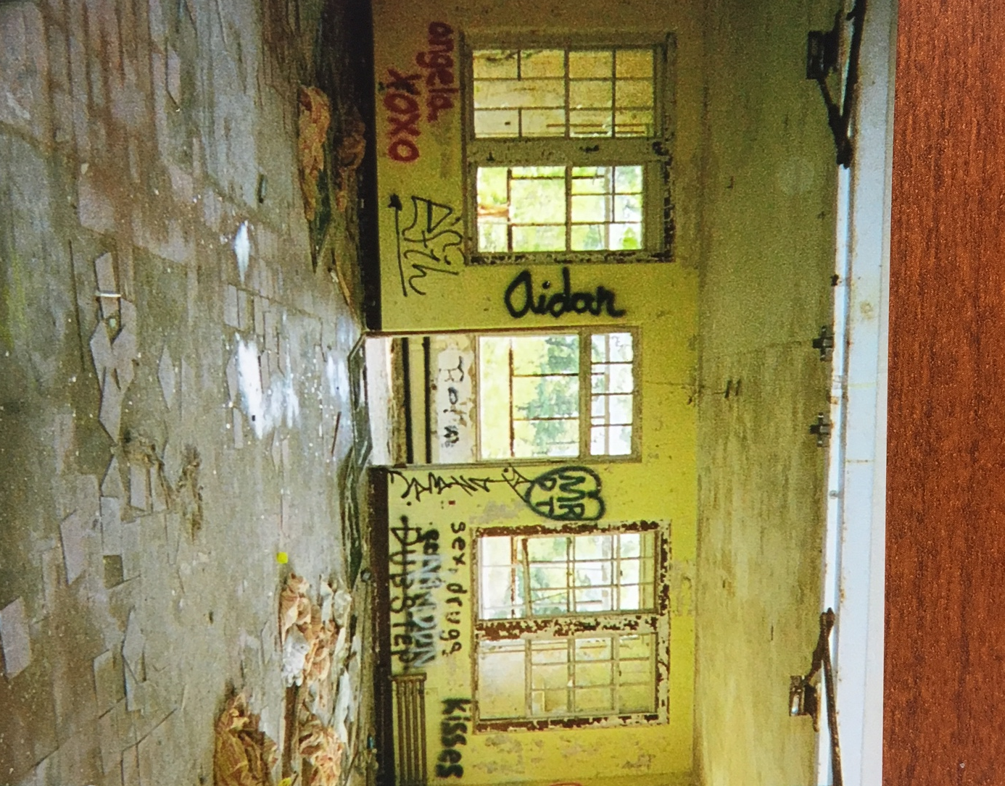

Slide 17
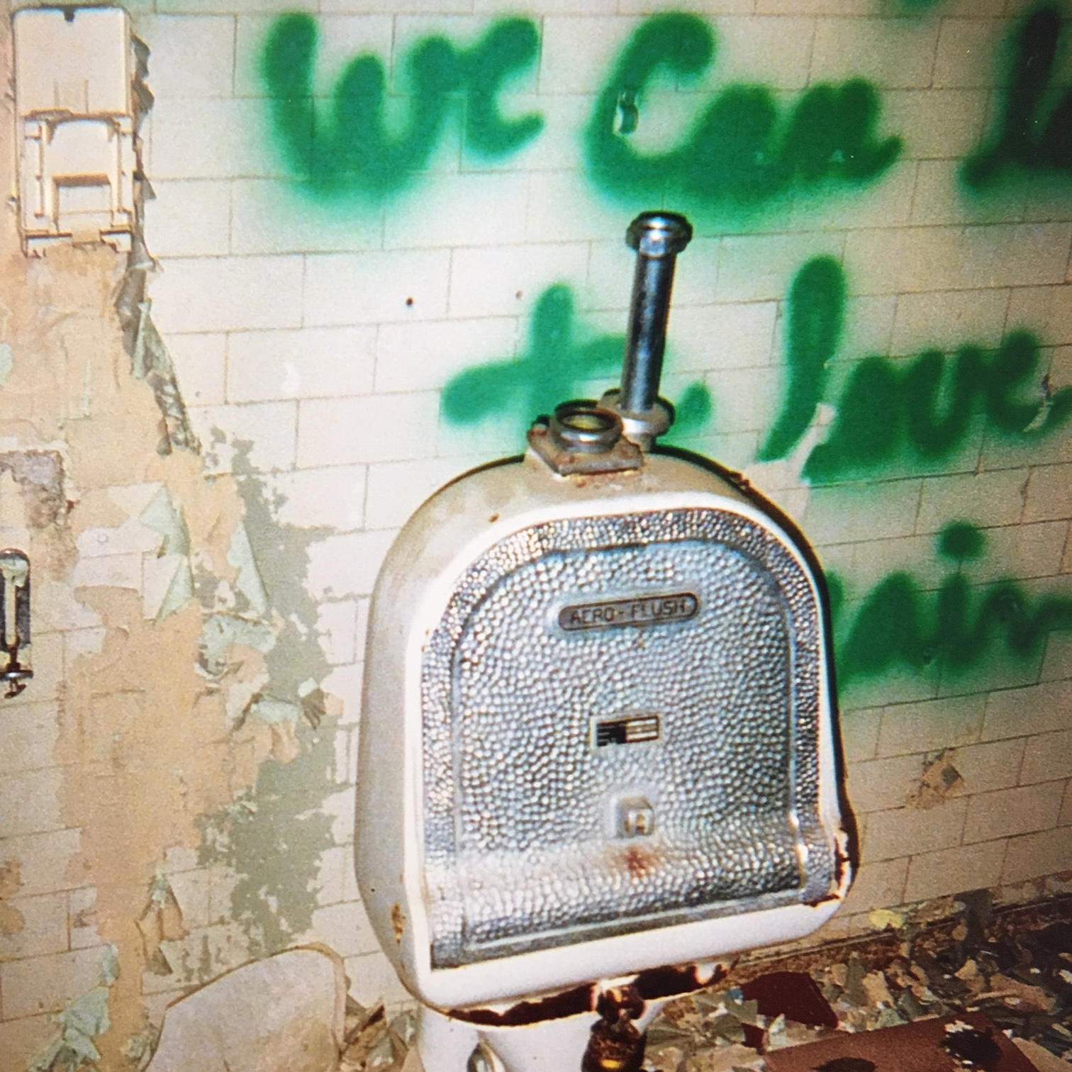

Slide 18
Exploring options for 8-acre PCH parcel
Committee actions:
Reviewed feasibility report from Old Colony Planning Council
Reviewed initial info on cost of demolition
Met with:
Teresa Santalucia, Hanson Housing Authority (HHA)
Laura Kemmett, Community Preservation Committee
Josh Cutler, State Representative
South Shore Chamber of Commerce CEO

Slide 19
Exploring options for 8-acre PCH parcel (con’t)
Toured property with nonprofit developers
Michael Mattos of Affordable Housing and Services Collaborative
Jeremy Wilkins of Urban Edge
Looked into Recovery Centers of America
Applied to Urban Land Institute for technical assistance
Attended open house for Braintree solar field
Toured PCH property with solar company representative
Held several walks on property for community members

Slide 20
Lessons learned to date
Demolition costs = at least $1.5 million plus (2015 estimate)
(waiting for details of recent estimates)
Housing Authority:
Reorganized and is well-positioned to play a role as needed
Could apply for CPC funding for portion of demolition; requires land be used for open space protection, historic preservation, affordable housing or outdoor recreation

Slide 21
Lessons learned to date
Very limited public funds available for elderly or over 55 housing.
More funding potential for affordable housing or a “transit-oriented development” district (close to commuter rail)
Medical treatment center (e.g., Recovery Centers of America as in Danvers)
Benefits: low traffic; tax revenue potential
Negatives: concerns about impact on abutters and community
ULI and SSCofC both feel best site use is to enhance quality & attractiveness of overall “South Hanson neighborhood”

Slide 22
Possible options to fund demolition of PCH
Seek developer proposal to demolish/incorporate cost into project
Seek developer proposal to demolish in exchange for 8 acres of land
No “traction” yet generated on these lines; soils and infrastructure limit opportunities
Concerns: Less town control of site future; cost of community services (COCS) may outweigh revenues

Slide 23
Possible options to fund demolition of PCH (con’t)
Use a combination of funds:
Community Preservation Act (CPA) funds (but limits on use and timing could be an issue)
Grants (we were not able to find funds for demolition)
Special account established by BOS (funded by proceeds from sale of town-owned properties)
Tax
No “strings attached”, maximizes flexibility in usage
Possibly defray via revenues from solar array

Slide 24
Preliminary committee recommendations
These are preliminary recommendations – discussions ongoing
Committee makes no final decisions – up to Board of Selectmen and town residents to decide what ultimately happens

Slide 25
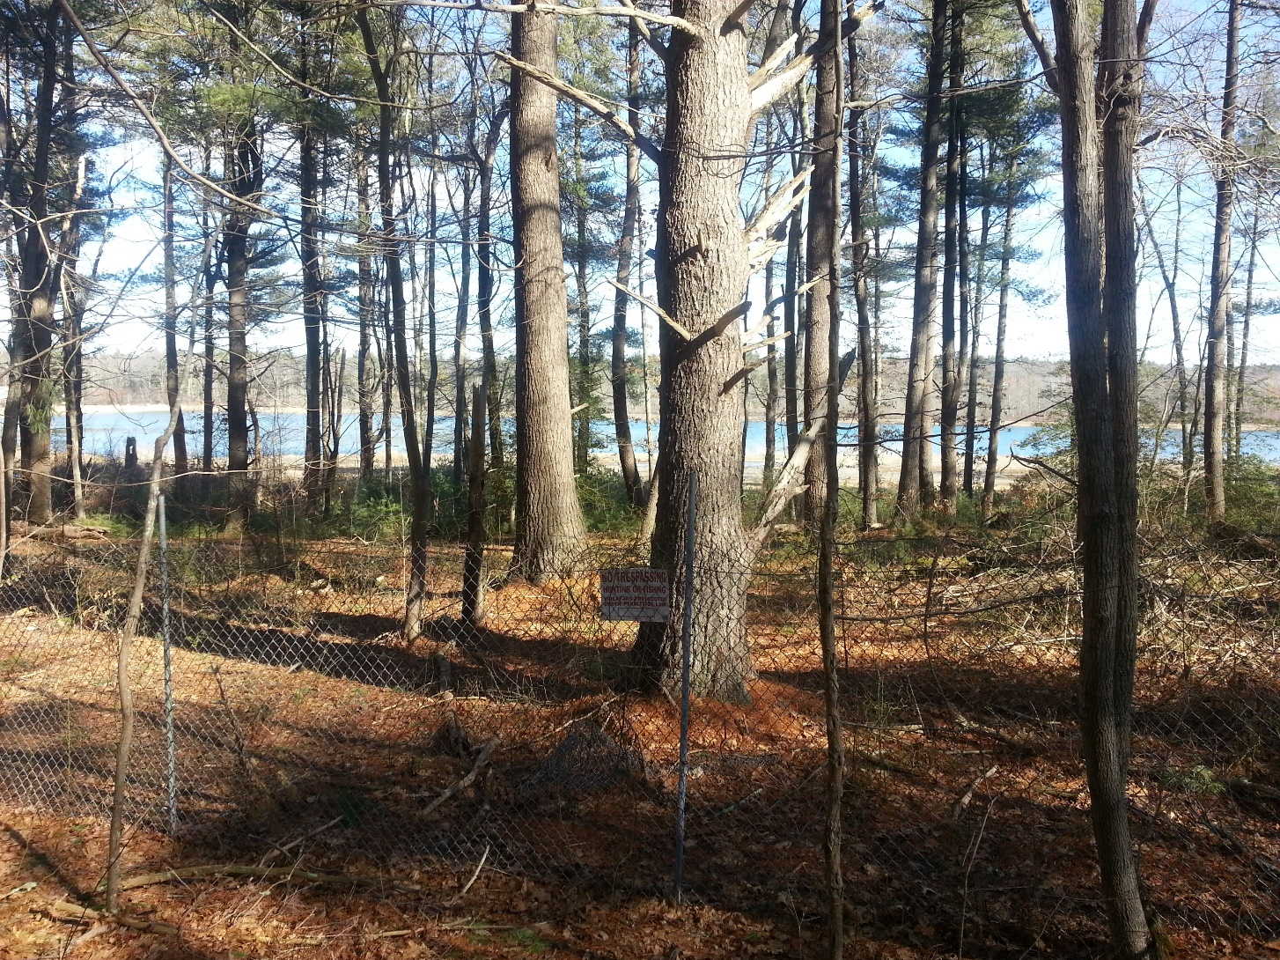
Old hospital building
Complete initial estimate of cost to decontaminate & demolish
Request town approval for bond;
Develop and send out requests for proposal (RFP) for:
Decontamination
Demolition

Slide 26
Potential Recommendations for Parcel 1
Solar field?
Provides income for town and would help defray cost of demolition
Minimal neighbor impact – retain vegetative barriers
Keeps land available for future use (easy to take down in future)
Power Purchase Agreements (PPA) means no cost to town to design, install, operate
Workforce/affordable housing?
Consider a small number of units (two 2-family units?); could be eligible for affordable housing funding

Slide 27
Potential Recommendations for Parcel 2
Keep food pantry building and community garden
Appraise/sell superintendent house; proceeds to dedicated fund
Develop remaining land for community use – suggestions:
Town green encircled by walking paths
Playground – low maintenance design
Passive lifelong recreation for all ages – “tots to elders”
Link to Bay Circuit Trail & Greenway – off-road route
Bandstand or amphitheater? Dog park?
Retain Bonney House as historic/education center
Identify footprint needed for second Water Tower

Slide 28
Recommendation for Parcel 3
Maintain and improve current trail system
New Bay Circuit Trail link between Pierce Avenue and Bonney Hill Lane
Seek state Recreational Trails Grant
Relocate BCT off High Street
Control invasive species, preserve old meadows
Bonney House/Farm historic connection:
Last remnant of 1800s agricultural landscape

Slide 29
What’s next?
Complete competitive estimates for cost of decontamination & demolition
Consider Town Meeting article to fund demolition
Pursue other means to reduce taxpayer impact
Potential CPC funds?
Sale of tax title properties?
Solar field revenues?
Caution on “cost of community services”

